Slide 1
Minimum Spanning Tree
Prim’s Algorithm

Slide 2
Problem: Laying Telephone Wire
Central office

Slide 3
Wiring: Naïve Approach
Central office
Expensive!

Slide 4
Wiring: Better Approach
Central office
Minimize the total length of wire connecting the customers

Slide 5
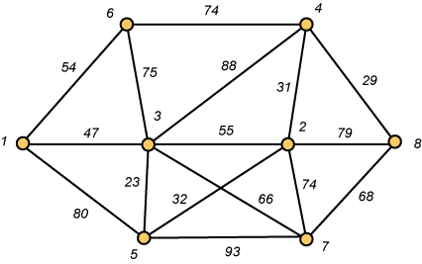
A Networking Problem
Problem: The vertices represent 8 regional data centers which need to be connected with high-speed data lines. Feasibility studies show that the links illustrated above are possible, and the cost in millions of dollars is shown next to the link. Which links should be constructed to enable full communication (with relays allowed) and keep the total cost minimal.

Slide 6
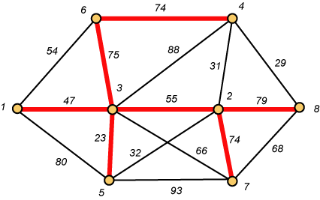
Links Will Form a Spanning Tree
Cost (T) = 47 + 23 + 75 + 74 + 55 + 74 + 79
= 427

Slide 7
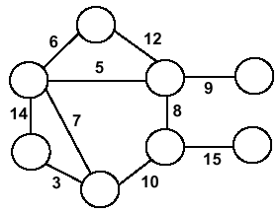
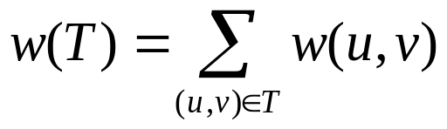
Minimum Spanning Trees
Undirected, connected graph G = (V,E)
Weight function W: E → R (assigning cost or length or other values to edges)
Spanning tree: tree that connects all the vertices (above?)
Minimum spanning tree: tree that connects all the vertices and minimizes

Slide 8
Minimum Spanning Tree (MST)
A minimum spanning tree is a subgraph of an undirected weighted graph G, such that
it is a tree (i.e., it is acyclic)
it covers all the vertices V
  contains |V| - 1 edges
the total cost associated with tree edges is the minimum among all possible spanning trees
not necessarily unique

Slide 9
How Can We Generate a MST?
9
b
9
b
a
2
6
a
2
6
d
d
4
5
4
5
5
4
5
4
5
e
5
e
c
c

Slide 10
Greedy Choice
We will show two ways to build a minimum spanning tree.
A MST can be grown from the current spanning tree by adding the nearest vertex and the edge connecting the nearest vertex to the MST. (Prim's algorithm)
A MST can be grown from a forest of spanning trees by adding the smallest edge connecting two spanning trees. (Kruskal's algorithm)
Notes:
Three Algorithmic Paradigms
Greedy: build up a solution incrementally, myopically optimize some local criteria
Divide and conquer: break up a problem into non-overlapping subproblems, solve subproblems independently, and then combine solutions to the subproblems to form solution to the original problem.
Dynamic programming: break up a problem into a series of overlapping subproblems, and build up solutions to larger and larger subproblems

Slide 11
Notation
Tree-vertices: in the tree constructed so far
Non-tree vertices: rest of vertices
Prim’s Selection rule
Select the minimum weight edge between a tree-node and a non-tree node and add to the tree

Slide 12
The Prim algorithm Main Idea
Select a vertex to be a tree-node
while (there are non-tree vertices) {
if there is no edge connecting a tree node with a non-tree node
return “no spanning tree”
select an edge of minimum weight between a tree node and a non-tree node
add the selected edge and its new vertex to the tree
}
return tree
6
a
4
b
5
u
14
2
10
c
v
3
8
15
d
f

Slide 13
Prim’s Algorithm
Vertex based algorithm
Grows one tree T, one vertex at a time

Slide 14
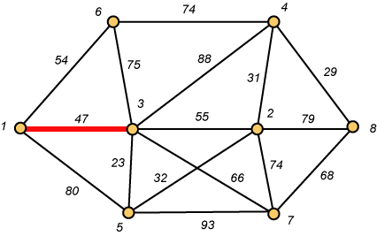
Prim – Step 1

Slide 15
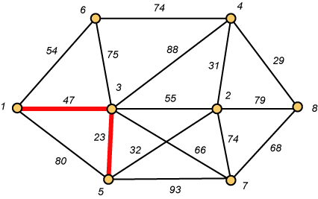
Prim – Step 2

Slide 16
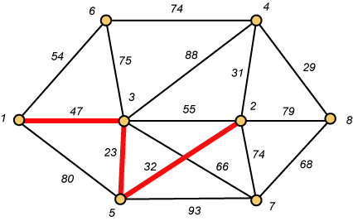
Prim – Step 3

Slide 17
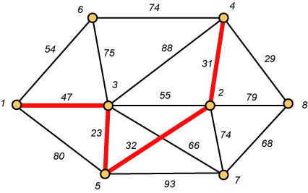
Prim – Step 4

Slide 18
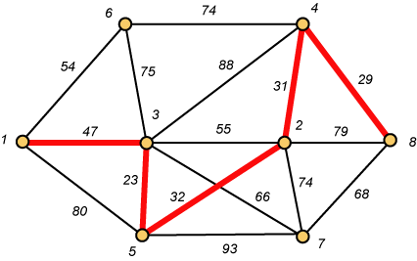
Prim – Step 5

Slide 19
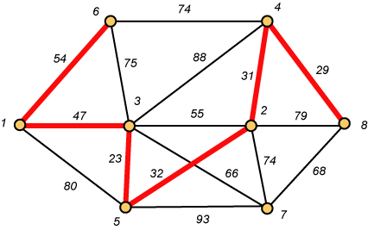
Prim – Step 6

Slide 20
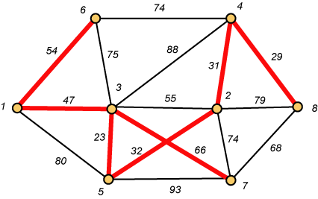
Prim – Step 7 Done!!
Weight (T) = 23 + 29 + 31 + 32 + 47 + 54 + 66 = 282

